Slide 1
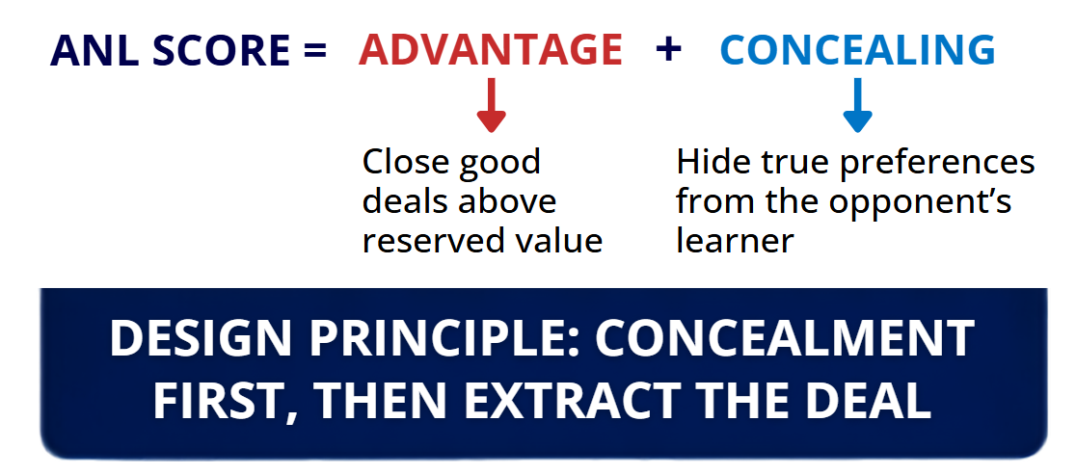
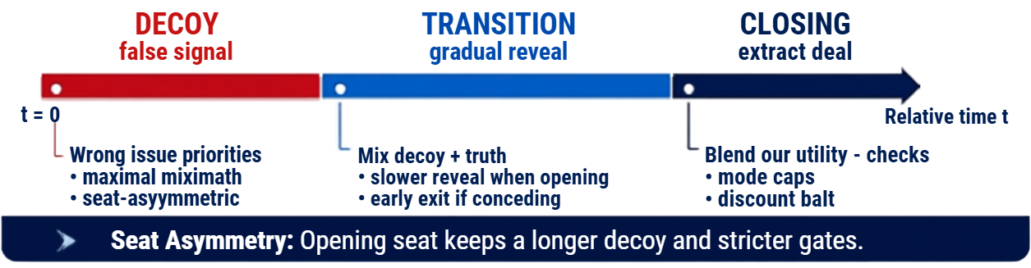
Agent360: A Concealment-First Bilateral Negotiator for ANL 2026
Noam Kazum · Omer Shani Steinmetz · Dr. Galit Haim · Dr. Raz Lin
The College of Management Academic Studies · ANL / ANAC 2026 · June 2026
The Goal
Opponent Model
Inference uses only the bid stream, relative time, and seat.
Never read opponent class or true utility.
Base: Smith frequency model - value counts per issue → normalized utility estimate.
Design principle: concealment first, then extract the deal
Recency-blended Smith
On the second seat, blend full-history Smith with a short recent window so late persona shifts are not ignored.
Time-weighted Smith
Late-phase bids count more heavily, reducing contamination from early decoy posturing on either side.
Architecture
Bid stream only - no opponent class, no true utility
Issue-weighted Smith
Issues with repeated values are down-weighted; diverse issues get higher weight.
Offer trajectory
Track concession slope, non-monotonic rises and predict utility.
Bidding
Persona
Opponent
Model
Deal
Extraction
Bidding Persona
Mode Response
Conceding - Early decoy exit, chase agreement
Learner - Full blend, no bait discount
Deceptive - Discount Smith, reject bait
Mirro - Plain Smith, anti-mirror bids
Unknown - Conservative full blend
Key Idea
Match the opponent mode and adjust concealment strength accordingly.
Seat asymmetry: opening seat keeps a longer decoy and stricter gates
Acceptance
Evaluation
Catastrophe floor near deadline
Mode aspiration - slope follows opponent mode
AC-next - as good as our next concealing bid
Bait guard - block deceptive utility spikes
Sparring | Stress | Learners
mirror · bait-switch · strong learners | Time-based NegMAS baselines | BOA · MAP · MiCRO
63% | 95% | 48% | wins
Acceptance
What We Rejected
Why
Concealment must be maintained until we have strong deal.
Conceal first, then extract.
Overall 71% wins in in-house evaluations, in the ANL 2026 qualification the agent reached the 32nd place and didn’t reach the finals.
Reverse-psychology
(truth early)
hurts Concealing vs learners
Mid-game escape accept
took mediocre / deceptive deals
Catastrophe floor near deadline
Mode aspiration - slope follows opponent mode
AC-next - as good as our next concealing bid
Bait guard - block deceptive utility spikes
Result pattern: strong Concealing against stress agents; competitive balance on learner and deceptive panels. Promoted: early decoy exit, mode closing caps, first-seat decoy rotation, anti-mirror pools, catastrophe accept. Removed after regressions: reverse-truth persona, mid-game escape acceptance, overly strict first-seat gates.
Conclusions
Concealment first
Decoy early and reveal later.
Seat asymmetry
Improving score against
learners match ups
Test across panels
Robust on learners, stress and deceptive agents
Separate controls
For concealing and acceptance
for bigger adavntage.

